Slide 1
ORGANISATIONAL
BEHAVIOUR
CHAPTER-6
PERCEPTION AND ATTRIBUTION

Slide 2
LEARNING OBJECTIVES
Perception is an important input in individual behaviour. It refers to the process of seeing what is there to be seen.
The receiver, the received, and the situation will influence one’s perception.
Perceptual process comprises several steps: Receiving stimuli, selecting stimuli, organizing stimuli, interpreting stimuli, and reacting to sensory stimuli.
Noticing some stimuli and screening out others is called selecting stimuli. Both external as well as internal factors influence the selection of stimuli.
\Perceptual organization refers to the process by which people group stimuli into recognizable patterns so that meanings can be assigned to them.
Assigning meaning to the organised stimuli is called interpreting,
Attribution is the process by which an individual assigns attributes and causes to the behaviours of others.
Perceptual distortions occur because of projections, stereotypes, halo effects, self-fulfilling prophecies, and attributes.
Perception goes beyond influencing individual behaviour. It is an important variable affecting several areas of organizations. Managers do well manage perceptual process effectively.
Social perception is the process of understanding others accurately.

Slide 3
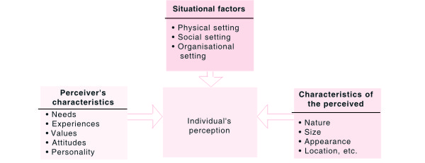
Factors Influencing Perception

Slide 4
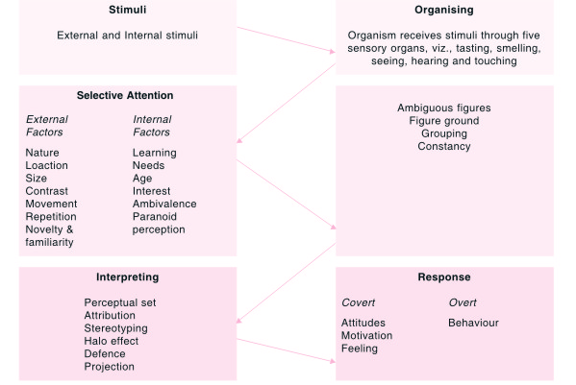
Perceptual Process

Slide 5
The Effects of Different Colours
Colour Psychological Effect Temperature Effect Distance Effect
Violet Aggressive and tiring Cold Very close
Blue Restful Cold Further away
Brown Exciting Neutral Claustrophobic
Green Very restful Cold/neutral Further away
Yellow Exciting Very warm Close
Orange Exciting Very warm Very close
Red Very stimulating Warm Close

Slide 6


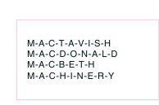
The Contrast Principle of Perception
Learning Principle

Slide 7



Attractive or Ugly Woman?
An Ambiguous Figure — a
duck or a rabbit
An Ambiguous Figure — a
kneeling woman or a man’s
face

Slide 8


A Figure Ground Experiement
Figure Background Demonstration

Slide 9




Principle of Similarity
Principle of Proximity
An Example of Perceptual
Continuity
The Principle of Closure

Slide 10


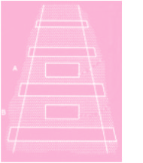

An Example of Perceptual Continuity

Slide 11
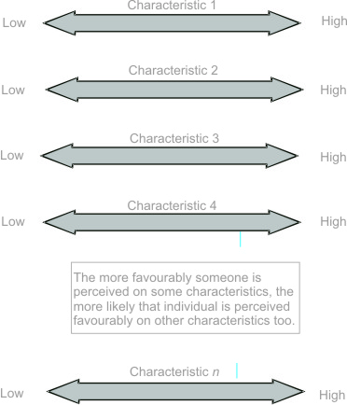
The Halo Effect: A Demonstration

Slide 12
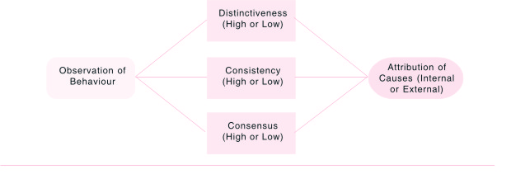
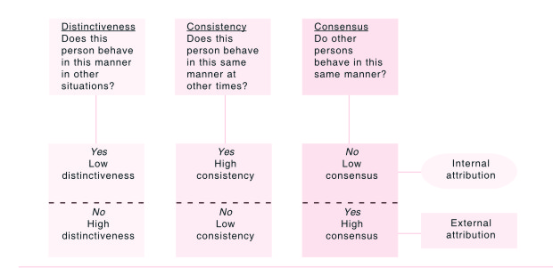
The Attribution Process
Rules of Attribution

Slide 13
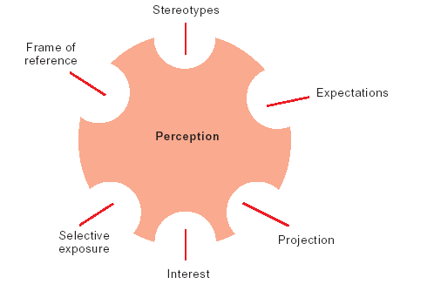
Biases Affecting Perception

Slide 14
Perception and OB
Helps understand the difference between perceived world and real world
Plays decisive role in employee hiring
Key role in performance appraisal
Helps determine loyalty of employees
Treating employees under Theory Y
Key role in impression management

Slide 15
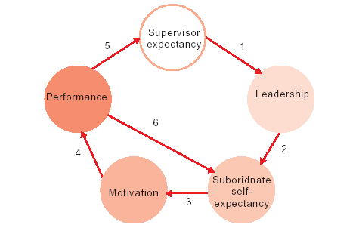
A Model of the Self-Fulfilling Prophecy

Slide 16
Managing Perceptual Process
        1. Have a high level of self-awareness: Individual needs, experience, and expectations can all affect perceptions. The successful manager knows this and is able to identify when he or she is inappropriately distorting a situation because of such perceptual tendencies.
        2. Seek information from various sources to confirm or disconfirm personal impressions of a decision situation: The successful manager minimizes the biases of personal perceptions by seeking out the viewpoints of others. These insights are used to gain additional perspective on situations and the problems or opportunities they represent.
        3. Be empathetic-that is, be able to see a situation as it is perceived by other people: Different people will define the same situation somewhat differently. The successful manager rises above personal impressions to understand problems as seen by other people.
        4. Influence perceptions of other people when they are drawing incorrect or incomplete impressions of events in the work setting: People act in terms of their perceptions. The successful manager is able to influence the perceptions of others so that work events and situations are interpreted as accurately as possible and to the advantage of all concerned.
        5. Avoid common perceptual distortions that bias our views of people and situations: These distortions include the use of stereotypes and halo effects, as well as selective perception and projection. Successful managers are self-disciplined and sufficiently self-aware so that the adverse impacts of these distortions are minimized.
        6. Avoid inappropriate attributions: Everyone has a tendency to try and explain why events happened the way they did or why people behaved as they did. The successful manager is careful to establish the real reasons why things happen and avoid quick or inappropriate attributions of casualty.27
        7. Diversity management programmes: As firms globalize themselves, diversity management assumes greater relevance. The challenge for corporate executives is to leverage the benefits of this diversity while minimizing the perceptual and behavioural problems that tend to accompany heterogeneity.
        OB experts have designed diversity management programmes. Typically, these training programmes serve two purposes. First, they communicate the value of diversity. Second, these programmes help participants become aware of their personal biases and give them more accurate information about people with different backgrounds, thus avoiding perceptual distortions.
        8. Know yourself: Apply the Johari window to know the real self. A powerful way to minimize perceptual biases is to know and become more aware of one’s values, beliefs, and prejudice.

Slide 17
Summary
        Perception refers to the process of receiving stimuli, selecting, grouping, understanding, and reacting to the external stimuli. Perception is influenced by the object of perception, the perceiver, and the situation in which the process occurs. It is an important variable in individual behaviour.
        Perceptual process comprises five important stages: receiving, selecting, organizing, interpreting, and reacting to the stimuli.
        Each stage in the perceptual process is influenced by several factors.
        Attribution is a corollary of perception. Attribution is the process of attributing causes to the behaviour of others. Attribution has implications for perception, leadership, and motivation.
        Perception plays spoilsport with human behaviour. Biases like stereotyping, halo effect, projection, attribution, and self-fulfilling prophecy distort perception.
        Perception has implications in such areas as employee selection, training, performance evaluation, testing one’s loyalty to the organization, and in deciding on appropriate managerial practices based on Theory X and Theory Y assumptions.
        Being an important variable in individual behaviour, perception needs to be managed effectively.
        Social perception is the process of understanding other people accurately.

Slide 18
Key Terms
Perception
Attribution
Pygmalion effect
Poggendorf illusion
Halo effect
Stereotyping
Projection
Stimuli
Ambivalence
Paranoid perception
Figure - ground
Impressions management
Corporate image
Social perception
Social Identity

